Slide 1

POSTMAN

Slide 2
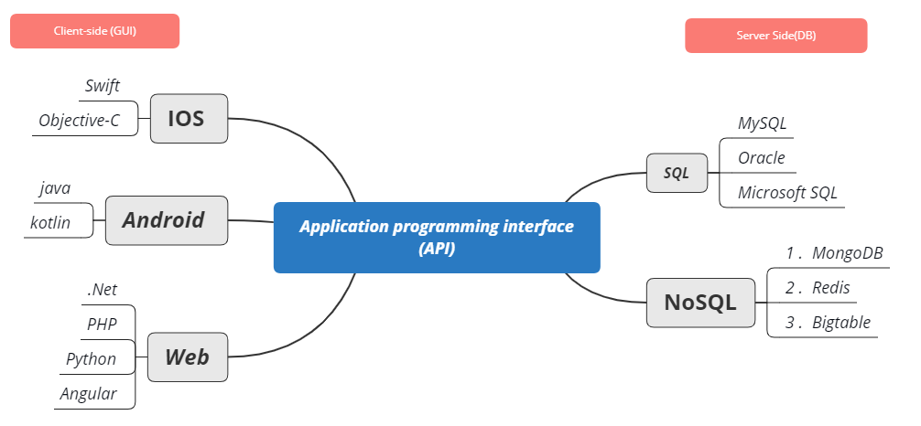

Slide 3
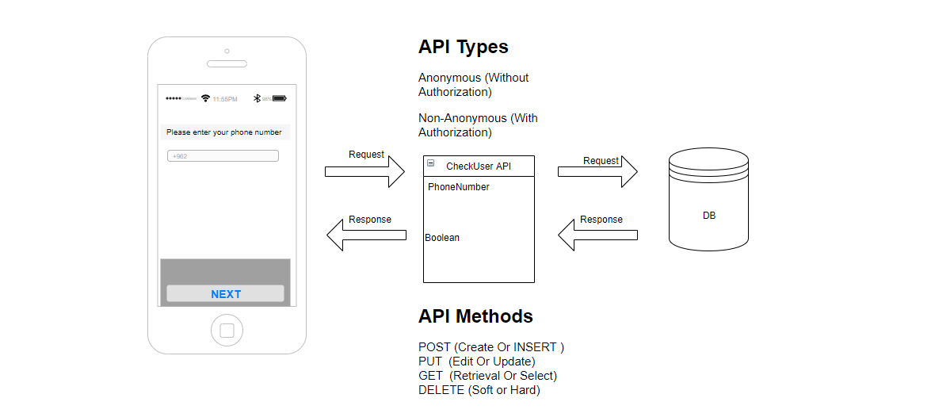

Slide 4
Major type of API
SOAP (Simple Object Access Protocol) allows different connected devices that run Windows or Linux to communicate using XML. The machines don’t need to use the same Operating System because they both understand the language of XML
REST (JSON ) (Representational State Transfer) is a very popular Web Communication Service that powers 70% of the web currently.

Slide 5
HTTP Status Codes
Status Code | Status
200 - GET | Success OK !
201 - POST | Success OK !
404 | Not Found
422 | Validation
405 | Method Not allowed
400 | Bad Request Bug! -> Bug
429 | Many request
500 | Internal Server Error
503 | Service Unavailable
524 | Timeout

Slide 6
What does JSON stand for?
JSON (Javascript Object Notation) is an open-standard file format derived from JavaScript.

Slide 7
What is Postman? Free
Postman is currently one of the most popular tools used in API testing.
It started in 2012
To simplify API workflow in testing and development. API stands for Application Programming Interface which allows software applications to communicate with each other via API calls.

Slide 8
Why Use Postman?
Accessibility - To use Postman, one would just need to log-in to their own accounts making it easy to access files anytime, anywhere as long as a Postman application is installed on the computer.
Use of Collections - Postman lets users create collections for their API calls. Each collection can create subfolders and multiple requests. This helps in organizing your test suites.
Creation of Tests - Test checkpoints such as verifying for successful HTTP response status can be added to each API calls which help ensure test coverage.
Automation Testing - Through the use of the Collection Runner or Newman, tests can be run in multiple iterations saving time for repetitive tests.
Debugging - Postman console helps to check what data has been retrieved making it easy to debug tests.

Slide 9
How to setup Postman?
https://www.postman.com/downloads/
Import postman collection (APIs)
Import environment (Server URL)

Slide 10
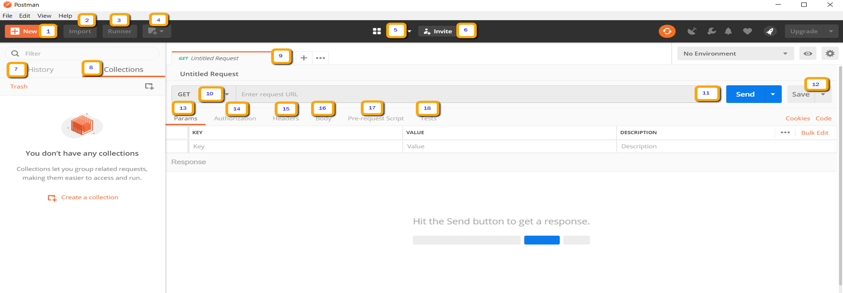
How to use Postman

Slide 11
New - This is where you will create a new request, collection or environment.
Import - This is used to import a collection or environment. There are options such as import from file, folder, link or paste raw text.
Runner - Automation tests can be executed through the Collection Runner.
Open New - Open a new tab, Postman Window or Runner Window by clicking this button.
My Workspace - You can create a new workspace individually or as a team.
Invite - Collaborate on a workspace by inviting team members.
History - Past requests that you have sent will be displayed in History. This makes it easy to track actions that you have done.

Slide 12
8. Collections - Organize your test suite by creating collections. Each collection may have subfolders and multiple requests. A request or folder can also be duplicated as well.
9. Request tab - This displays the title of the request you are working on. By default, "Untitled Request" would be displayed for requests without titles.
10.HTTP Request - Clicking this would display a dropdown list of different requests such as GET, POST, COPY, DELETE, etc. In testing, the most commonly used requests are GET and POST.
11. Request URL - Also known as an endpoint, this is where you will identify the link to where the API will communicate with.
12. Save - If there are changes to a request, clicking save is a must so that new changes will not be lost or overwritten.

Slide 13
13. Params - This is where you will write parameters needed for a request such as key values.
14. Authorization - In order to access APIs, proper authorization is needed. It may be in the form of a username and password, bearer token, etc.
15. Headers - You can set headers such as content type JSON depending on the needs of the organization.
16. Body - This is where one can customize details in a request commonly used in POST request.
17. Pre-request Script - These are scripts that will be executed before the request. Usually, pre-request scripts for the setting environment are used to ensure that tests will be run in the correct environment.

Slide 14
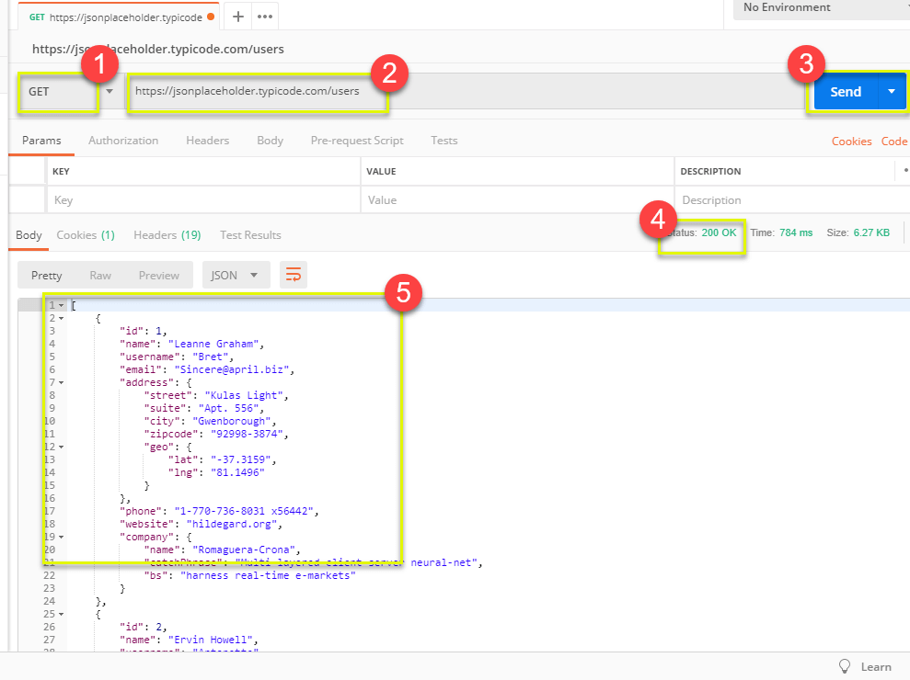
GET Requests

Slide 15
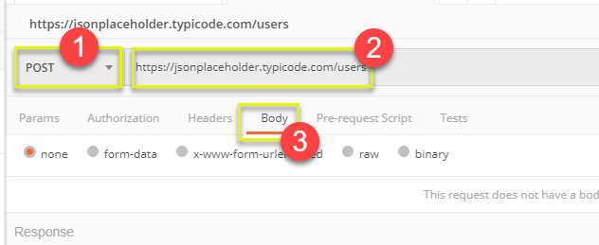
POST Requests

Slide 16
Roles & Responsibilities of a Software tester for testing API’s
Should able to use all the web methods like GET, POST, DELETE, etc
Validate the response, response time, error code
Able to validate the xml and Json body by using Json parsers
Performance and Security testing on web services
Able to read and understand the API documentations
Able to derive good number of test cases and scenarios.
Should be good in SQL queries to validate API and DB data elements

Slide 17
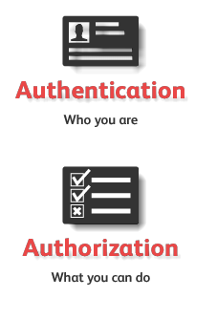
Authorization Vs. Authentication
Authentication : is a process of allowing or denying someone from accessing something.
Authorization : is a process of presenting your credentials to the system and the system validating your credentials. These credentials tell the system about who you are. This enables the system to ensures and confirm a user’s identity.

Slide 18
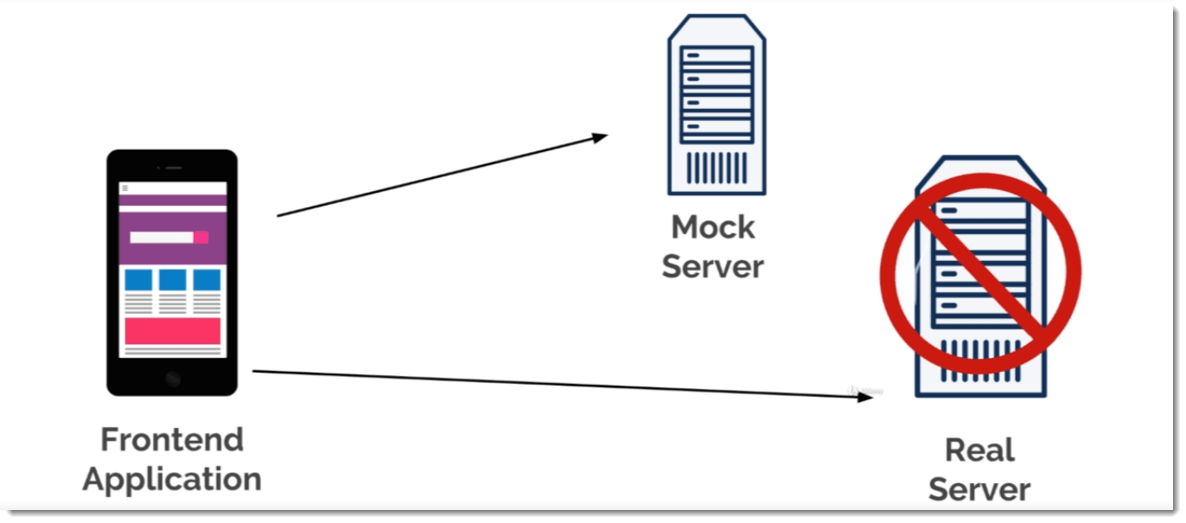
What is Mock Server?
A mock server is a server that is not a real server. It is just a fake server that is simulated to work as a real server so that we can test our APIs and check the response or errors.

Slide 19
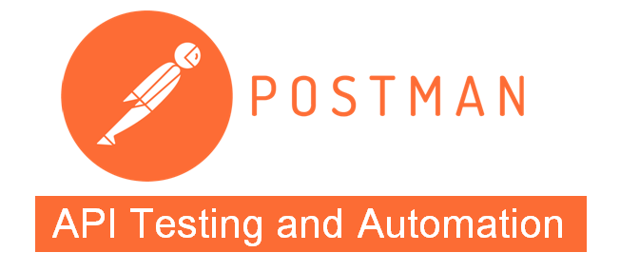

Slide 20
Writing Test
A test is simply an assertion (Check on Actual result Vs. Expected Result ).
You can have multiple test for the same API request.
The tests are run only after the request completed and response is received from server.
pm.test is the common function to write test

Slide 21
Check on Status code if 200 ?
Open any request
Go to test section
Click on “Status code is 200”
The following code will be added automatically
pm.test("Status code is 200", function () { pm.response.to.have.status(200);});
Click Sent
Check on test result if pass or fail

Slide 22
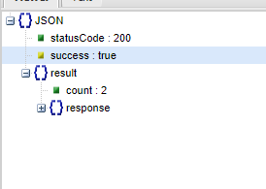
Response body :JSON Value Check
To check on received JISON from server
pm.test("Check on success Value", function () {
var jsonData = pm.response.json(); pm.expect(jsonData.success).to.eql(true);});
Check on {{url}}/api/carts/cartitems

Slide 23
To got value inside object
If our response contains of object inside object ,For example
Result object >> response object >> type priorities
NOTE: this example from {{url}}/api/carts/cartitems
pm.test("Cart type", function () {
var jsonData = pm.response.json(); pm.expect(jsonData.result.response.type).to.eql("Cart");});

Slide 24
Global Variable
To reduce duplication of code we can use Global variable (Code Refactoring) ex.Below code repeat all functions , To be make it as an Global Variable you should added before functions
var jsonData = pm.response.json();

Slide 25
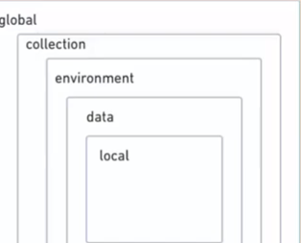
Variables
Dynamic Value
Similar to any program value
Variables Types : Global , Collection ,Environment ,Data , and Local

Slide 26
Pre-request Scripts
It is similar to test script but with no assertions
pm.environment.set("phonenumber",parseInt(Math.random()*100+2000900000));
For making your request dynamic
The order is :
1. Run per-request
2.Run HTTP request
3.Run Test

Slide 27
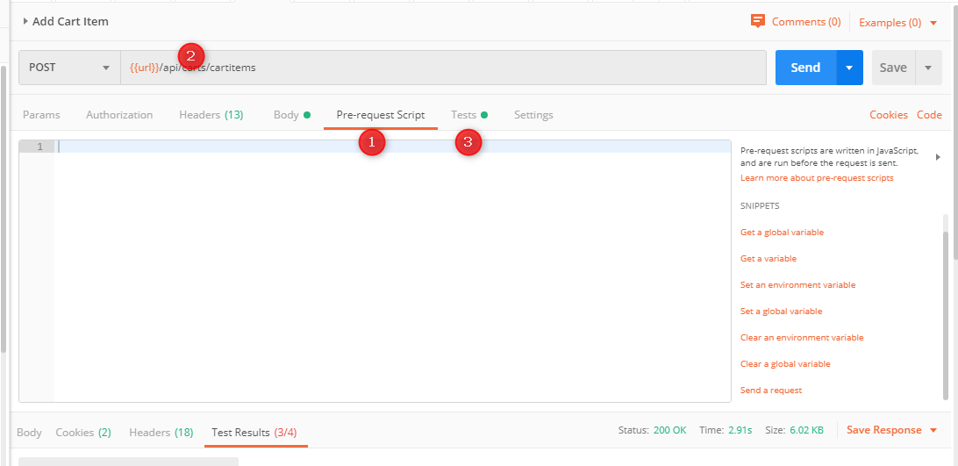

Slide 28
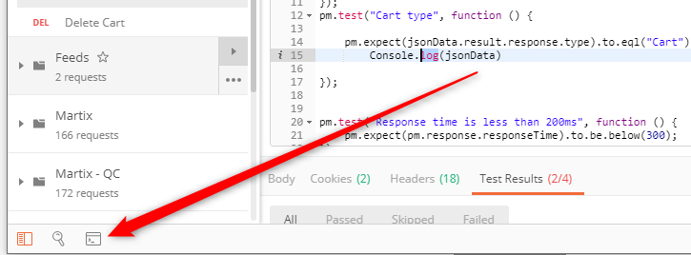
Debugging Tests
Using the below code
console.log(jsonData.result.response.type);
Then Check on Console page

Slide 29
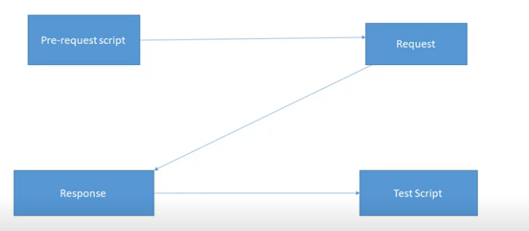

Slide 30
NOTE
In javascript everything is case sensitive

Slide 31
Advanced Assertions
Advanced Assertions using Chai Assertion Library (https://www.chaijs.com/api/)

Slide 32
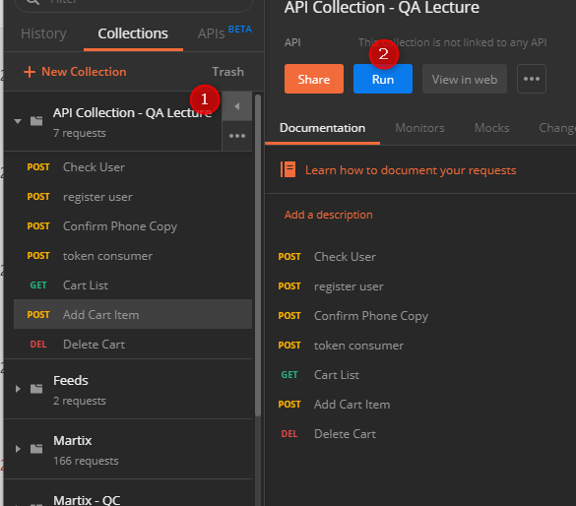
Run Collection - Automation Testing

